Slide 1
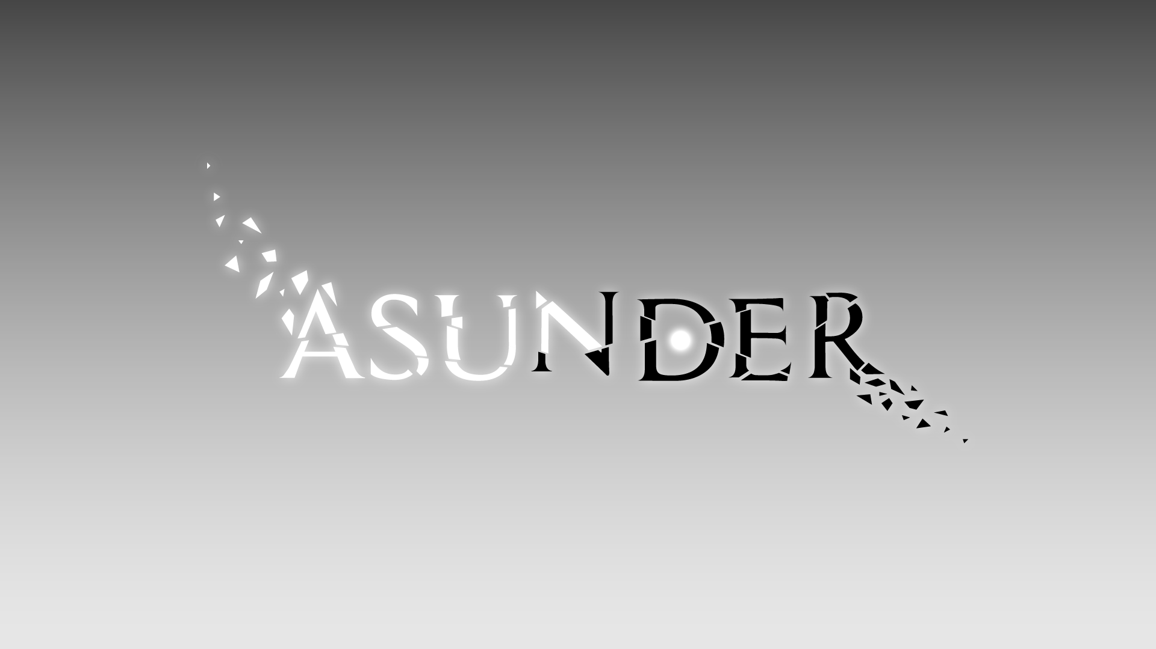
Notes:
ALEX / LARS
Welcome to the intermediate presentation of our narrative game “ASUNDER”, formerly known as “Fragments”.

Slide 2

HOW DEEP IS YOUR LOVE?
Self-acceptance
Past regrets
Reassembly
Notes:
LARS
Question we received was “How deep is your love?”
Didn’t want to tell a classical love story
Now about learning to love / accept yourself
Play in mind of character with many past regrets
Have to reassemble the character both figuratively and literally
[PASS ON TO ALEX FOR GENERAL INFORMATION]

Slide 3





BASICS
Notes:
ALEX
To give you a basic overview, ASUNDER is a…
…puzzle game
…in 3D space
…experienced from a 3rd person view
…for PC with gamepad support

Slide 4


TARGET AUDIENCE
25 – 35
Mid-core
All genders
Limited leisure time
Mental phenomena
Implicit storytelling
Notes:
ALEX
The target group we’re aiming at…
…is between 25-35 years old
…is of all genders
…plays games somewhat regularly
…prefers implicit storytelling
…is interested in mental phenomena
…does not have too much leisure time for playing

Slide 5

PRODUCTION PLAN
09/06/19
Final concept
23/06/19
Vertical slice of first level
07/07/19
Basic versions of other levels
16/07/19
Polish
Notes:
ALEX
To make sure we can live up to our vision we decided to…
…have a final concept until 9th of June
…create a vertical slice of the first level until 23rd
…add basic versions of the other levels until 7th of July
…and be done with everything until the 16th so there’s a bit of time for polishing and the final presentation
[PASS ON TO DANIEL FOR MECHANICAL SIDE OF DESIGN]

Slide 6

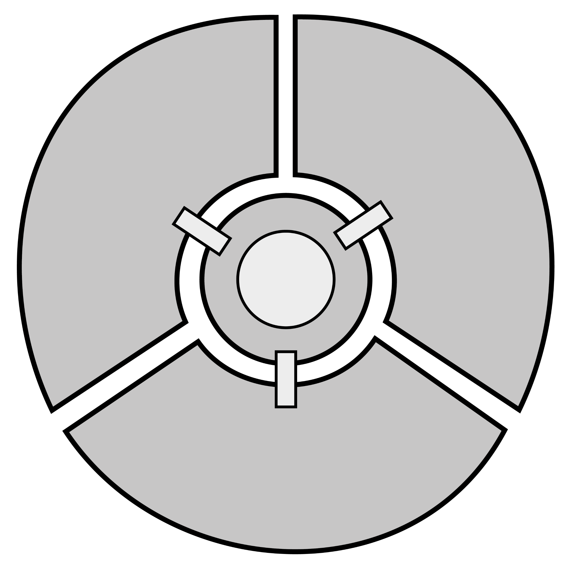
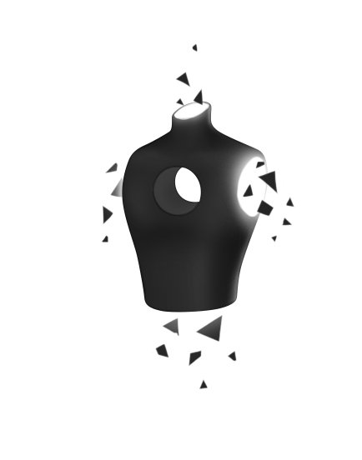
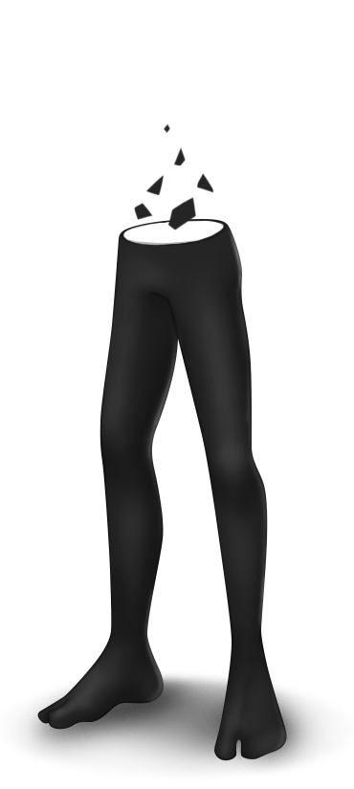
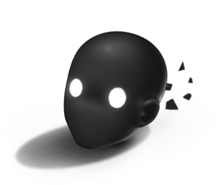
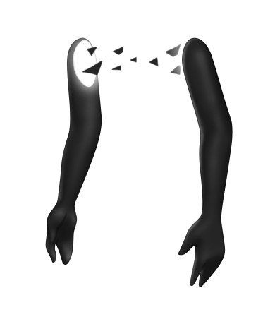
STRUCTURE
1
2
3
Notes:
DANIEL
The basic structure of the game focuses around the central HUB and the body part areas.
You start in the HUB playing just the head.
Then you enter the first area and grab your legs before returning to the HUB to unlock the next area.
This is repeated until you collected all body parts.
Fully reassembled you find a way in the HUB to exit the mind world.

Slide 7


GAMEPLAY
Enter
Unlock
Analyze
Solve
Notes:
DANIEL
On a high level, the gameplay loop looks something like that.
You enter an area, then you have a look at it and find the body part you need to reach.
To get there, some sort of puzzle has to be solved, which usually involved combining the abilities you collected so far.
With the new body part picked up, you return to the HUB and use the new ability to unlock the next area.
Repeat.

Slide 8

ABILITIES
Wall run
Push objects
Hook
Notes:
DANIEL
Each body part you find grants access to a new ability.
To make the game intuitive and easily accessible, we wanted to link the abilities to what the body parts are used for in real life.
The legs enable you to run up walls to reach places unavailable before.
With the torso, you can breathe out and push away light objects nearby.
Finally, the arms let you grab onto solid surfaces and be launched towards whatever you hit.
[PASS ON TO LARS FOR NARRATIVE ASPECTS]

Slide 9




NARRATIVE
Notes:
LARS
To make sure every person can enjoy ASUNDER, the game will be available in all 7111 languages of the world.
This is actually not that difficult for us because, well… there will be no text at all in the game.
Instead, the story will be told mainly through the environment and the tasks you have to complete in gameplay.
Our protagonist has burdened themselves with guilt in the past so every lost body part is connected to a painful memory of a past event.
This means that we’re telling 3 short stories in addition to the plot of working through these memories and learning to accept one’s own flaws.
Apart from the 3D environment, the players will be able to discover 2D memories illustrating the past events.

Slide 10
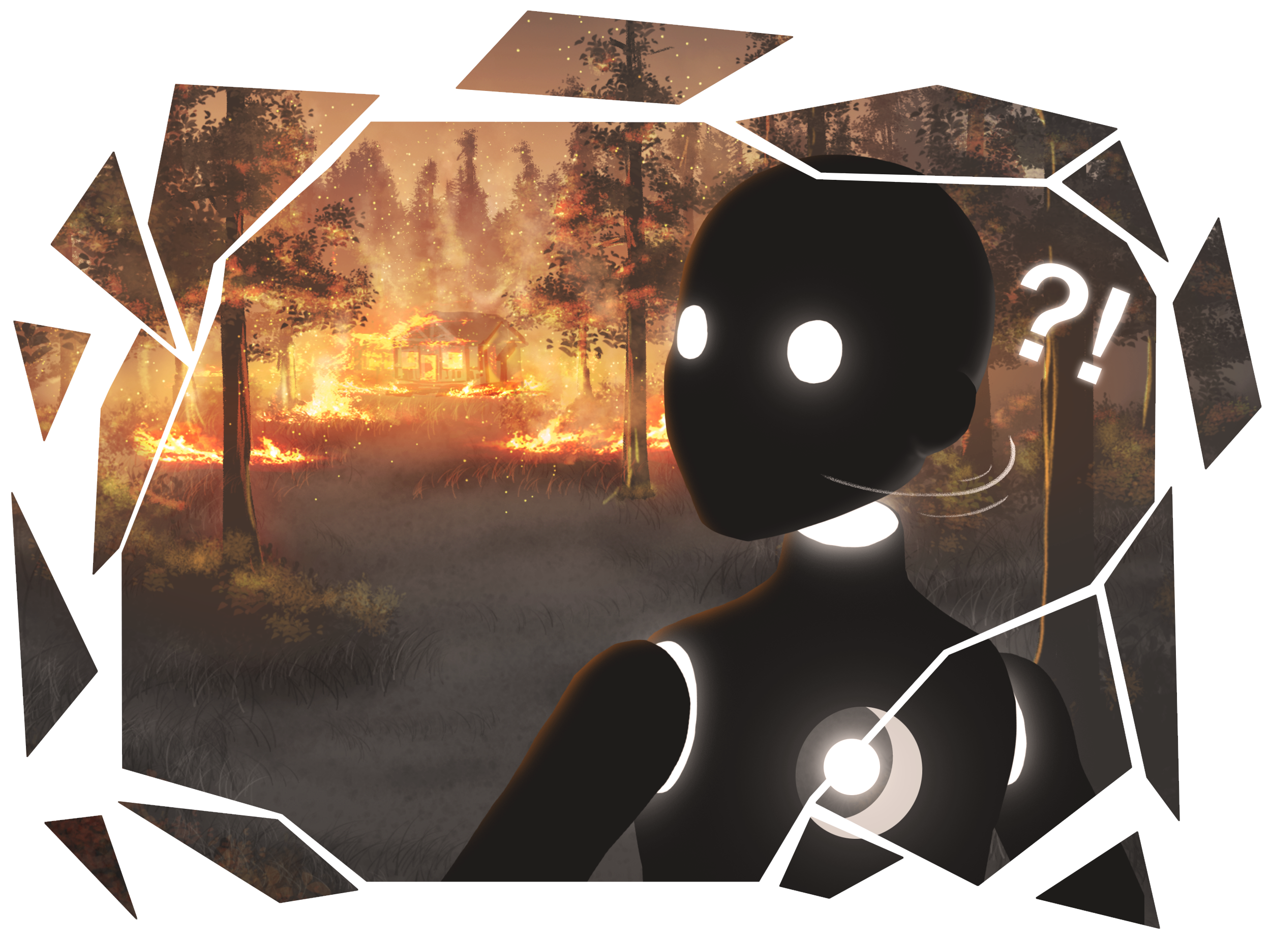
NARRATIVE
Cowardice
Notes:
LARS
To give you a specific example, we started with finding a storyline for the legs.
We agreed that legs can be a metaphor for cowardice because they’re very useful to run away.
We wanted to transport the idea of running away both on a literal or physical level and the figurative level of fleeing from responsibility.
This led to the story of our protagonist carelessly dropping a cigarette in a remote forest.
Unfortunately, this leads to a wildfire and the character is already about to call the firefighters when they drop their phone and run away to escape potential consequences.
So this is one of the short stories you will experience in both, the gameplay and the 2D memory shards.
[PASS ON TO ALEX FOR POSITIONING IN MEDIA HISTORY]

Slide 11
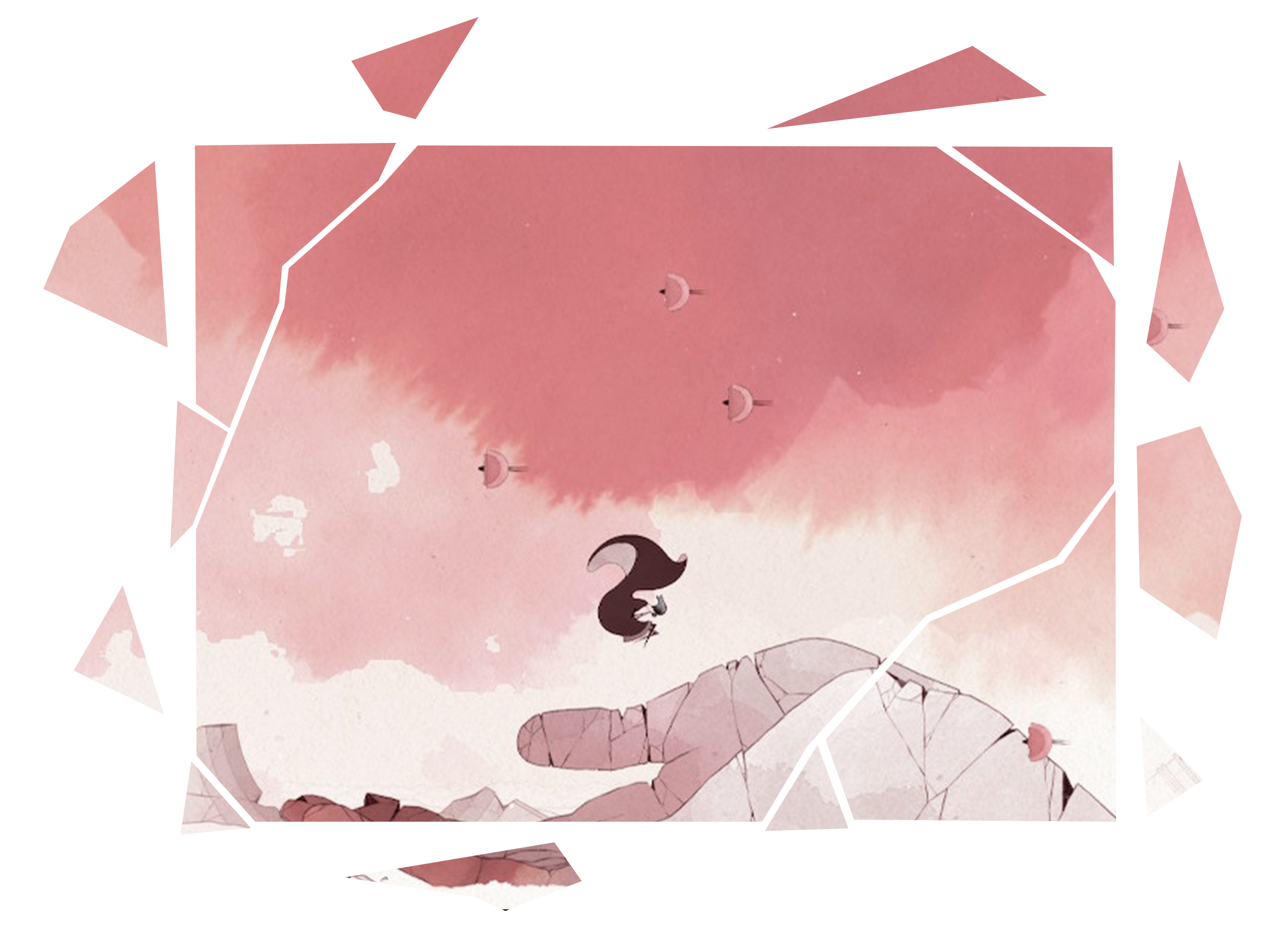
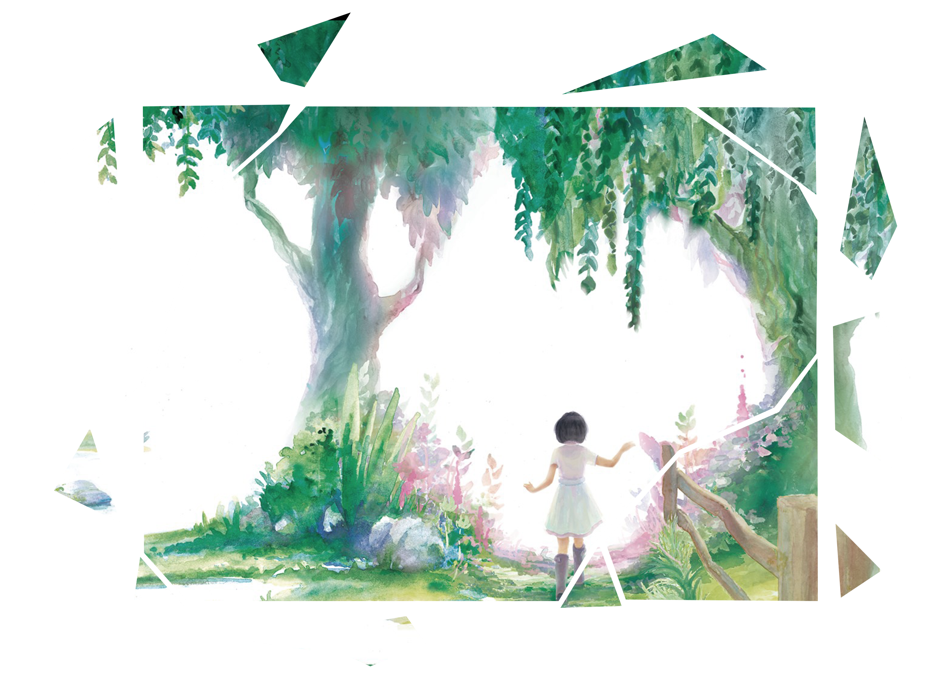
POSITION IN MEDIA HISTORY
World of the mind
Visual storytelling
Notes:
ALEX
We weren’t really inspired by specific games when coming up with the idea for “ASUNDER”.
Nevertheless, we are following certain modern trends from not only video games, but media in general.
As for the first trend, there are popular digital games that take place in the protagonist’s mind.
Gris and Psychonauts are examples for that.
Apart from that, our game relies on visual storytelling exclusively.
That’s something Beyond Eyes and The Unfinished Swamp do as well.

Slide 12
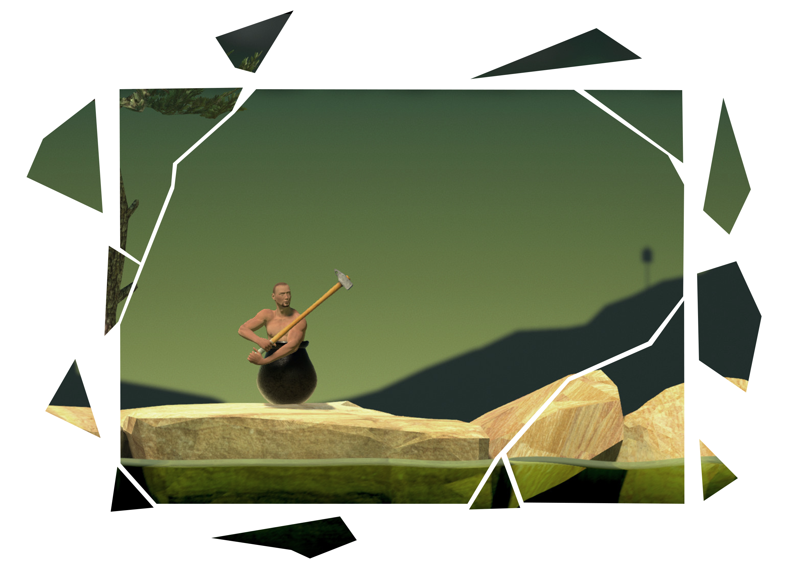
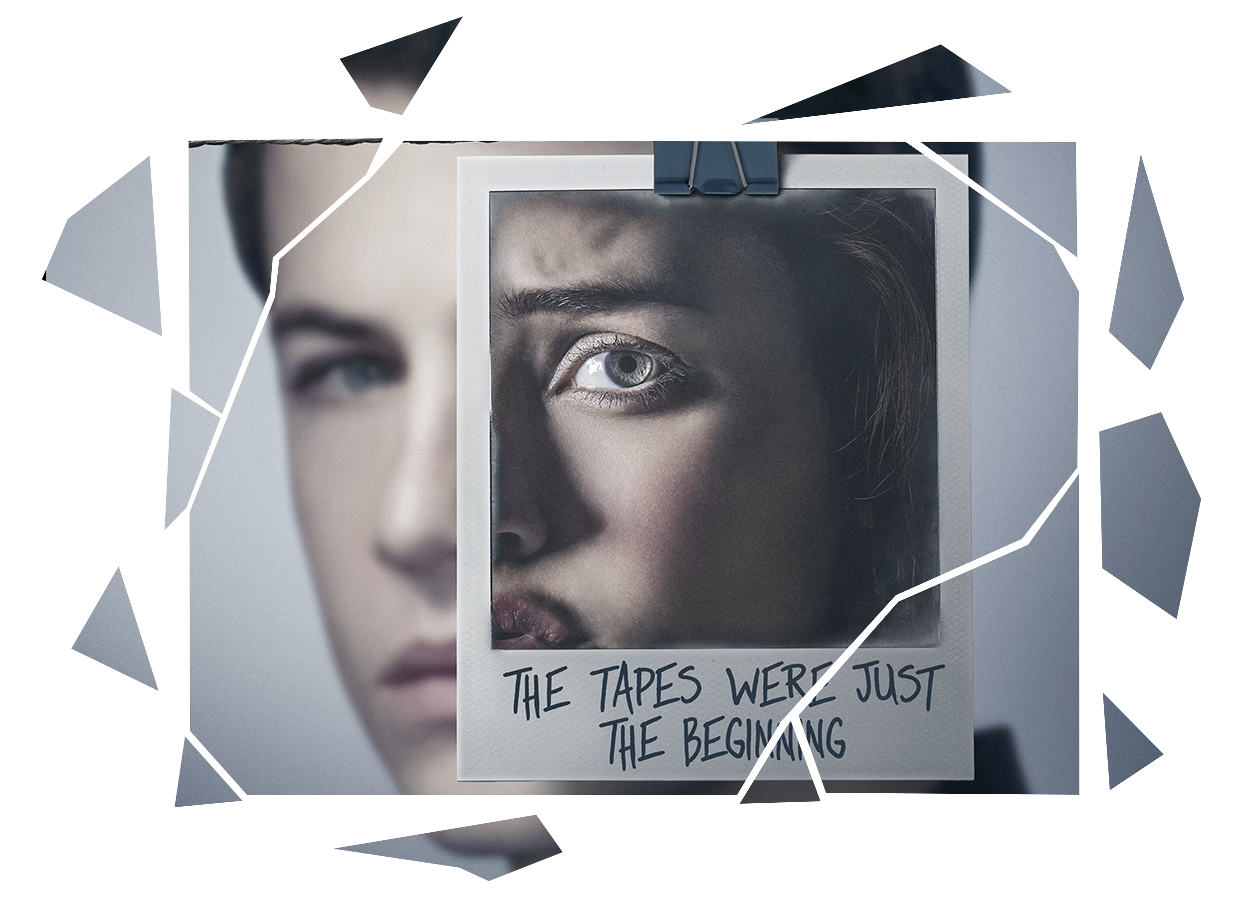
POSITION IN MEDIA HISTORY
Mental health
Self-acceptance
Notes:
ALEX
These trends were exclusive to games.
We’re also following a general trend in media to open up to issues of mental health.
The series Thirteen Reasons Why is one very popular example for that.
More specifically, we’re dealing with learning to live with one’s own flaws and past actions.
Getting Over It is a game that presents this theme in its title already.
[PASS ON TO THIAGO FOR TECHNICAL ASPECTS]

Slide 13



TECHNICAL APPROACH
Notes:
THIAGO
We decided very early on to use Unreal Engine 4 to build ASUNDER.
Right now we’re developing on version 4.22.2 which was the latest one when we started the project.
Also, we agreed to use the visual scripting system Blueprints because of the way it’s integrated into Unreal and so that non-programmers can do some of the coding work if need be.
To make sure everyone has the most recent version of the project at hands, we’re relying on GitHub for source control.

Slide 14
CLASS STRUCTURE
Character
Blueprint Component
Third Person Character
Ability Parent
Wall Run Ability
Breath Ability
Hook Ability
Notes:
THIAGO
The way we set up the different abilities was to create an individual blueprint component for each ability handling its functionality.
They all inherit from a parent ability class which is responsible for e.g. starting an ability or deactivating its use.
With that quite modular approach, our character class is kept organized and only has to contain a component for each ability.
[PASS ON TO TRIX FOR SOME PROGRESS UPDATES FROM THE ART DEPARTMENT]

Slide 15
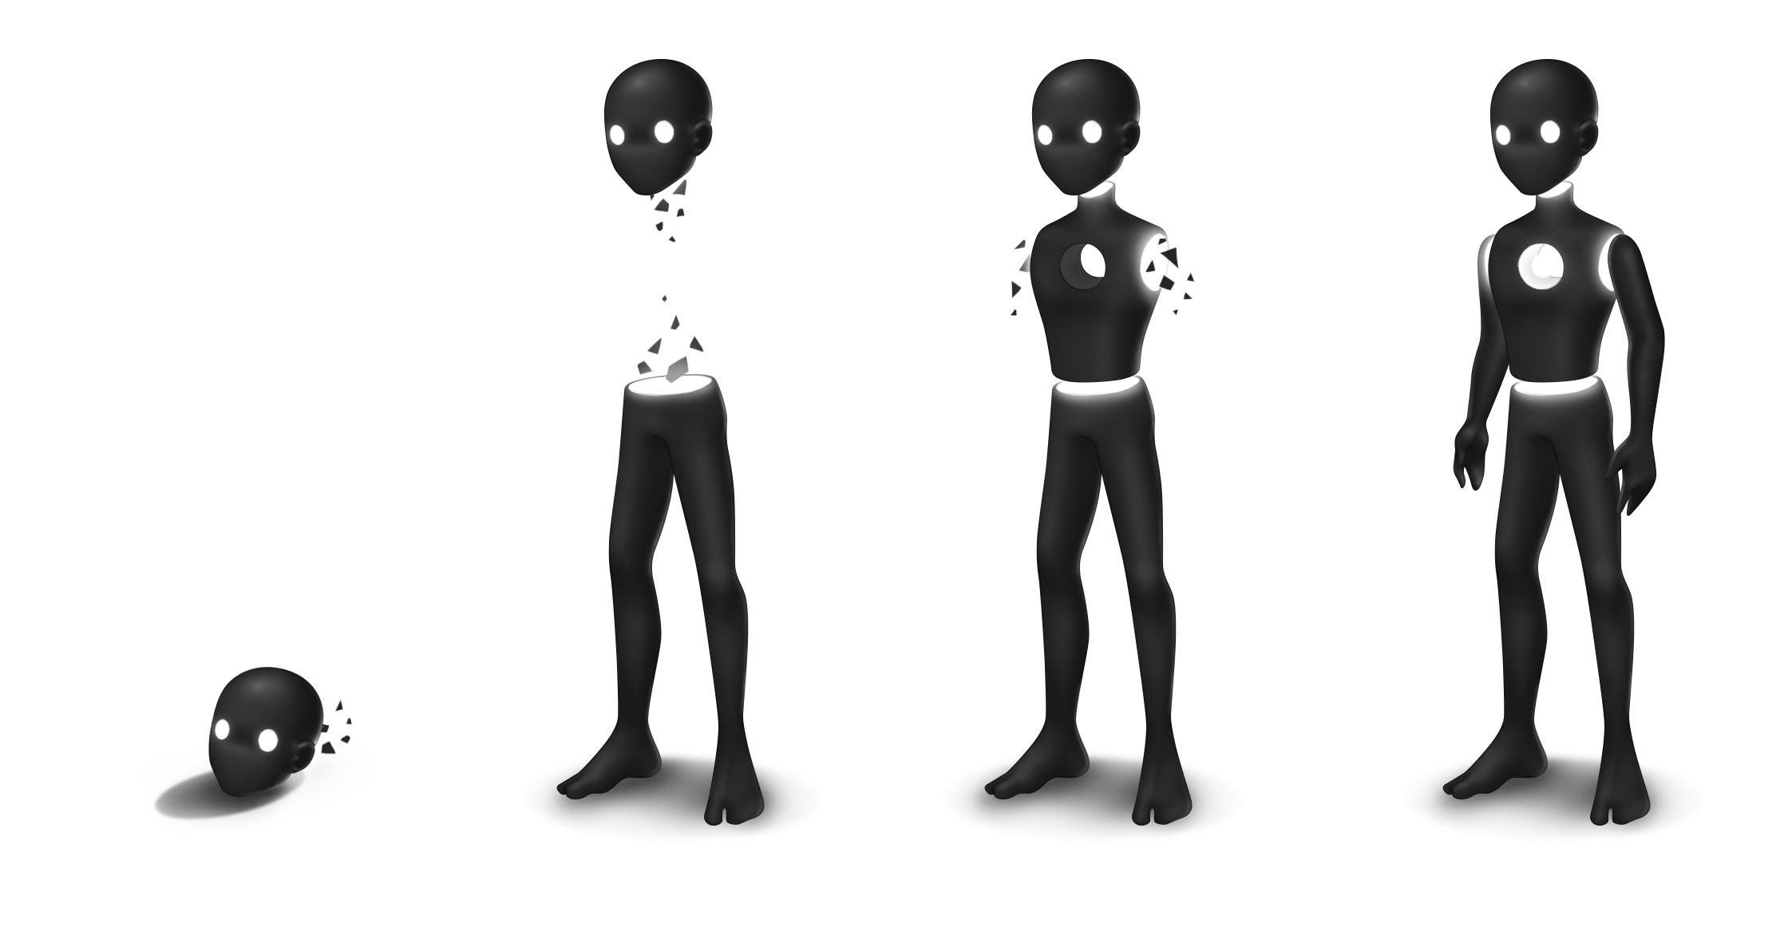
Art
Notes:
TRIX
Here you can see the final concept for our main character.
Because of the game’s structure, they need to have different stages they can be in.
Particle effects will indicate which parts are still missing.

Slide 16
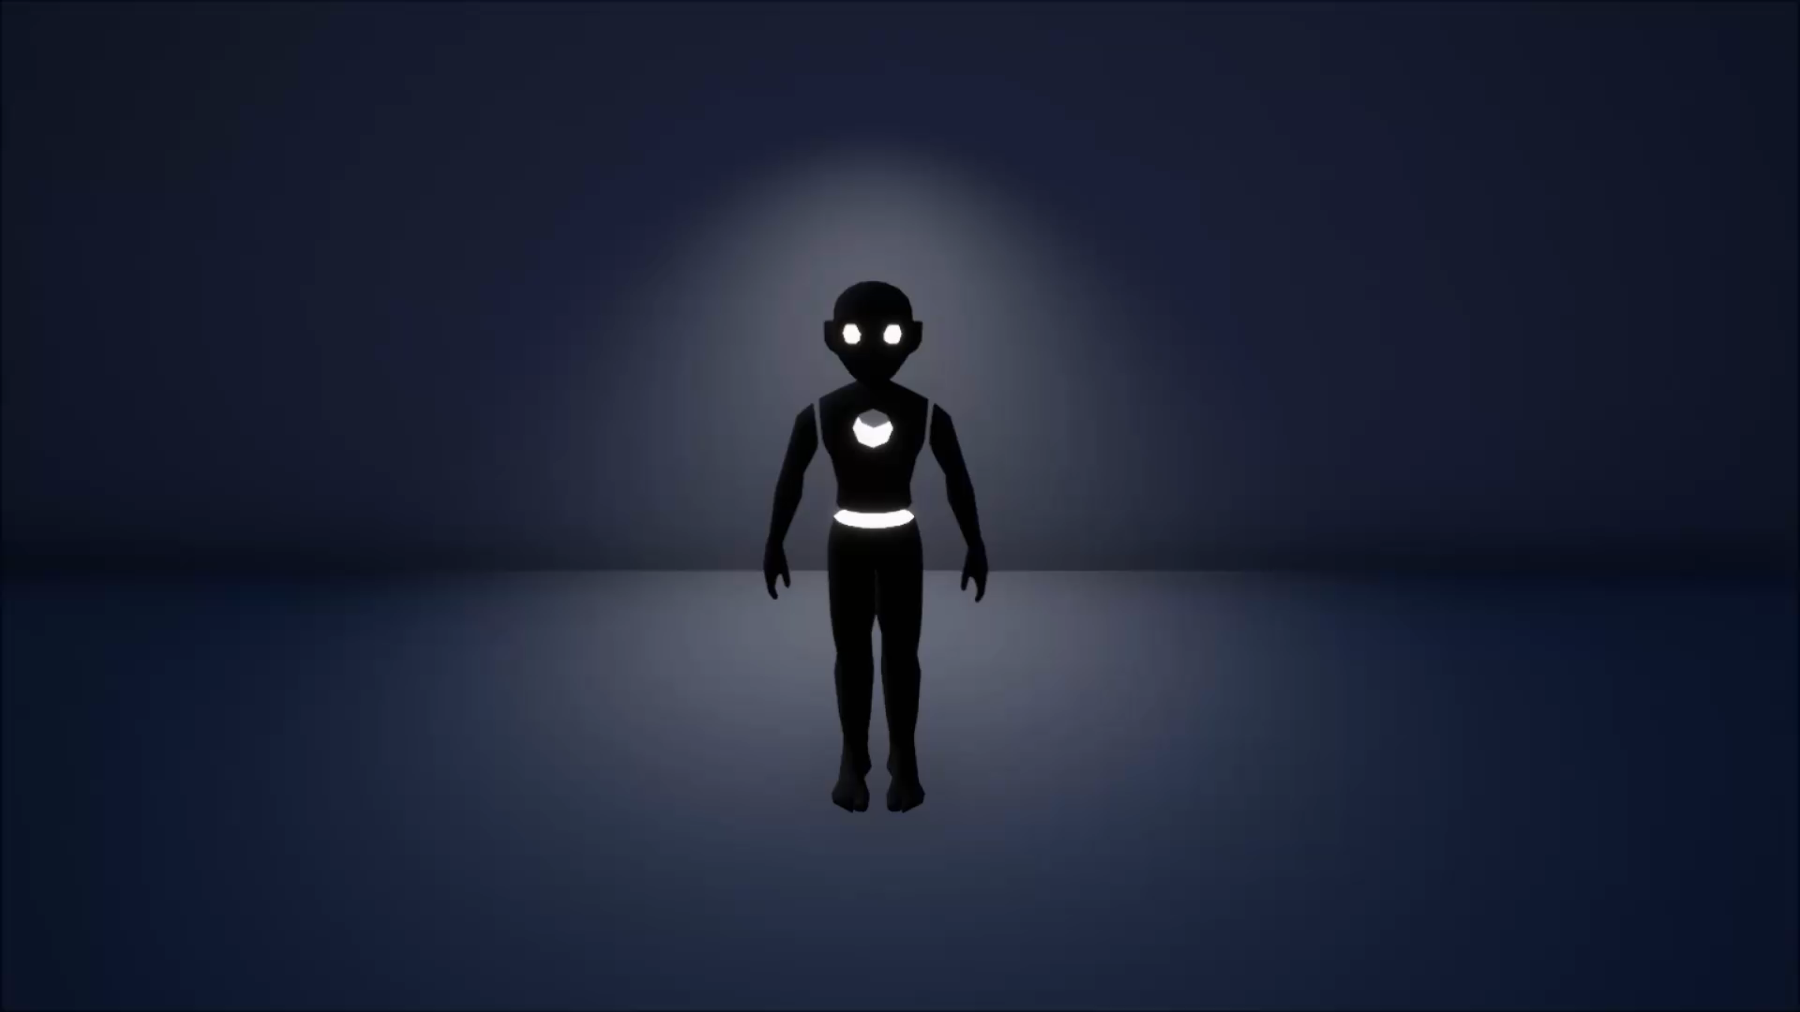
Art
Notes:
TRIX
Alex took my 2D concept and turned it into a fully rigged and skinned 3D mesh that you can see here.
We decided to model the fully assembled character first and then later split them up into the various parts.

Slide 17
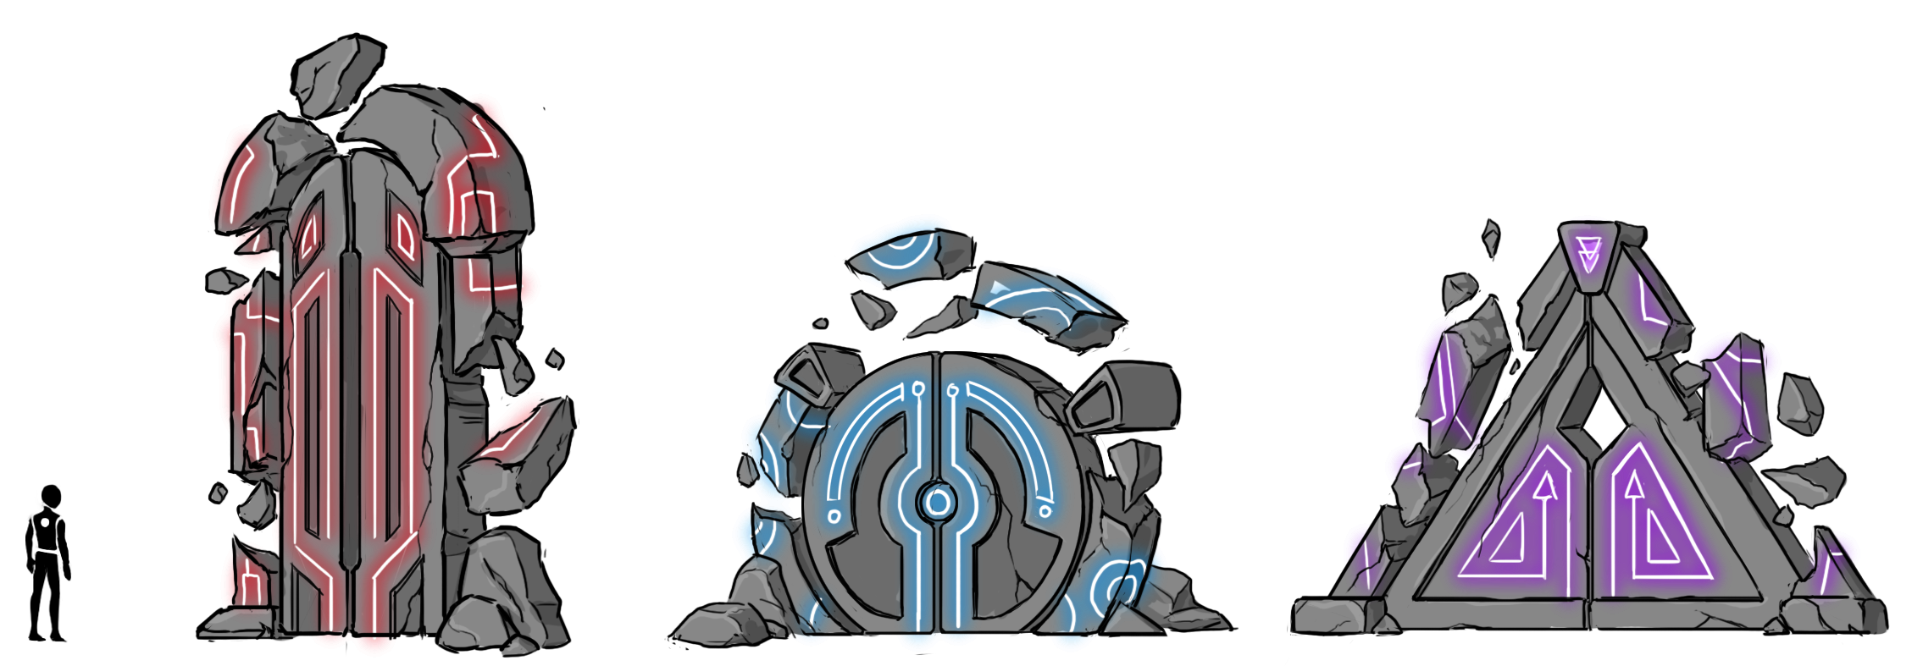
Art
Notes:
TRIX
Apart from designing the character, we also had to figure out the look of the game world.
A key part here were these three doors leading the player to the next area.
Each area has its own color theme (mainly accents) that is reflected in the doors and they also hint at the body part you are going to find.

Slide 18
GAMEPLAY VIDEO
1:00 of gameplay
footage
Notes:
TRIX
That’s the latest news from the art department.
Now, let’s have a look at about a minute of gameplay taking place in the final part of the game.

Slide 19
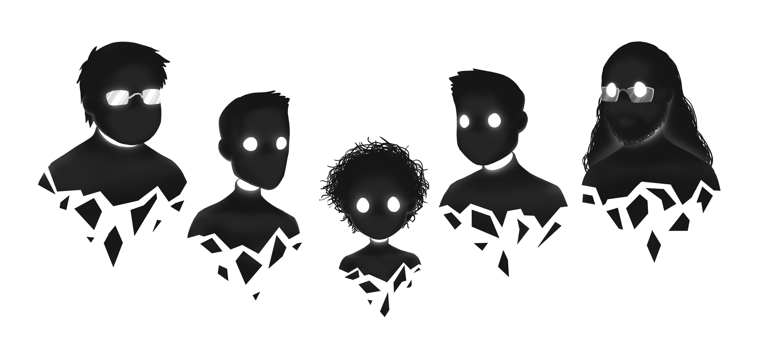




THANK YOU!
Notes:
ALEX
Thank you very much for your attention.
Are there any questions?

